Slide 1
Robot librarian
Group 4

Slide 2
Presentation Overview
Team distribution
Group Management
Software process model
System architecture
UML class diagrams
Sequence Diagrams
State Diagram
Implementation

Slide 3
Team distribution
Team Management and documentation
Abdullah Alhabib (371111359)
Modelling
Abdullah Alhasan (382124116)
Sultan Alodaib (391107956)
Sultan Alharbi (371111960)
Implementation
Mgren Almarshood (361111435)
Mothanna Almohaimed (391108661)

Slide 4
Group Management
Methods of communication
Whatsapp
Discord App
Repositories
Github
Discord App
Meeting pattern
When necessary

Slide 5
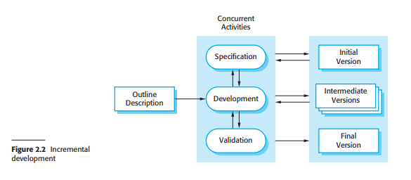
Software Process model
Incremental Development
Suitable for our lack of experience
Suitable for the nature of a semester
Easy to fix mistakes
Where it falls short
Harder to document the development
Cross team communication is harder

Slide 6
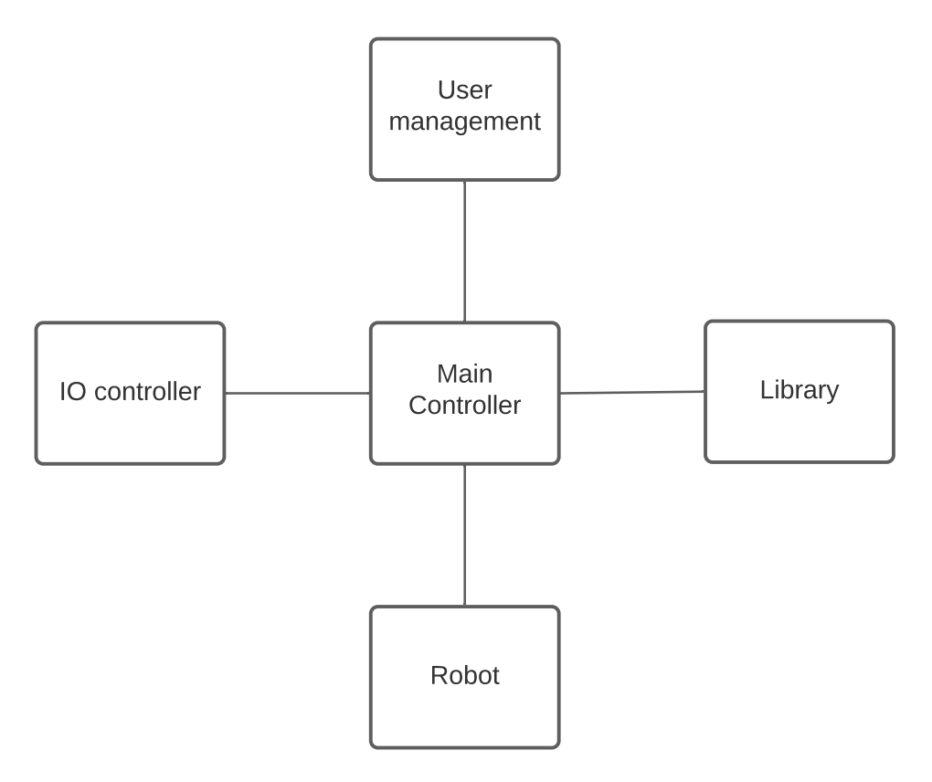
System Architecture
Goals from architecture
Scalabile
Modular
Evolutionary

Slide 7
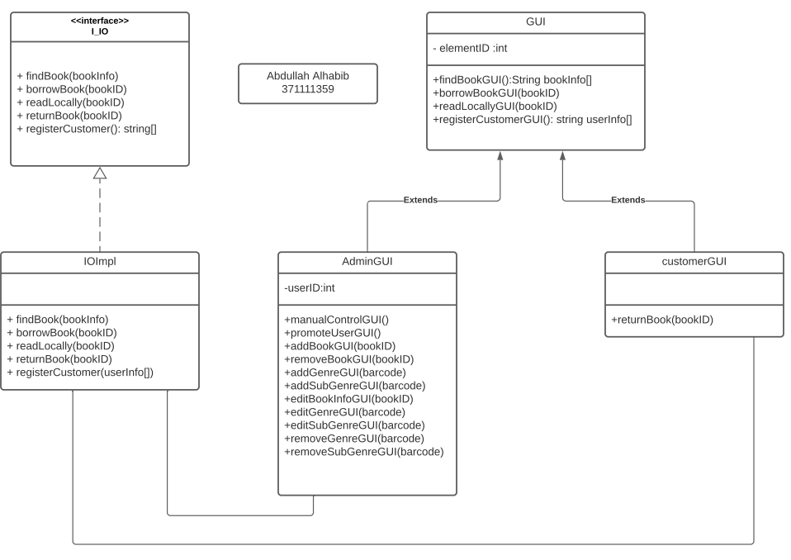
UML class Diagrams
Goals from design
Separate Admin from customer for security
Create an interface between the GUI interface and the robot

Slide 8
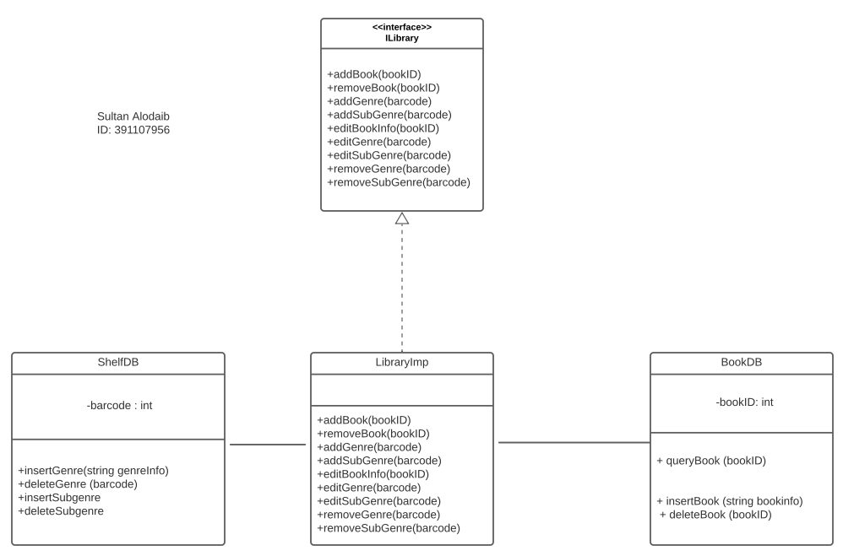
UML class Diagrams cont
Goals from design
Create an interface between the robot and library databases
Allow for management of barcodes and books

Slide 9
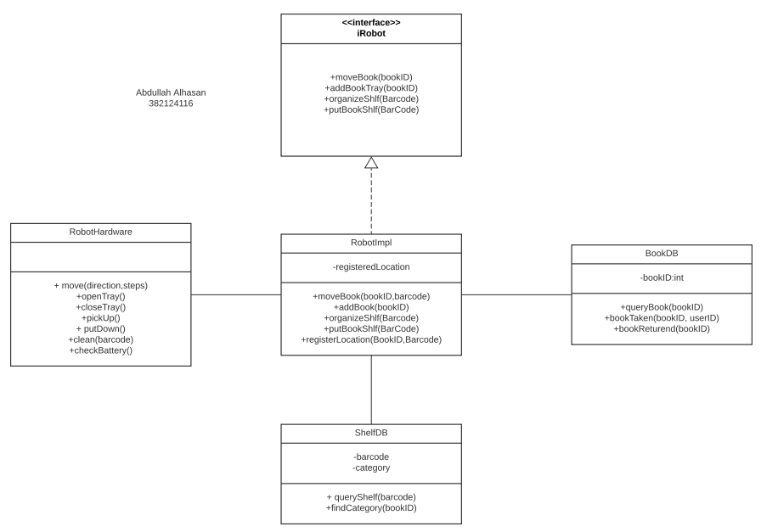
UML class Diagrams cont
Goals from design
Create an interface between the robot Hardware and our software
Manages robot behaviour for cleaning, borrow, return and movement

Slide 10
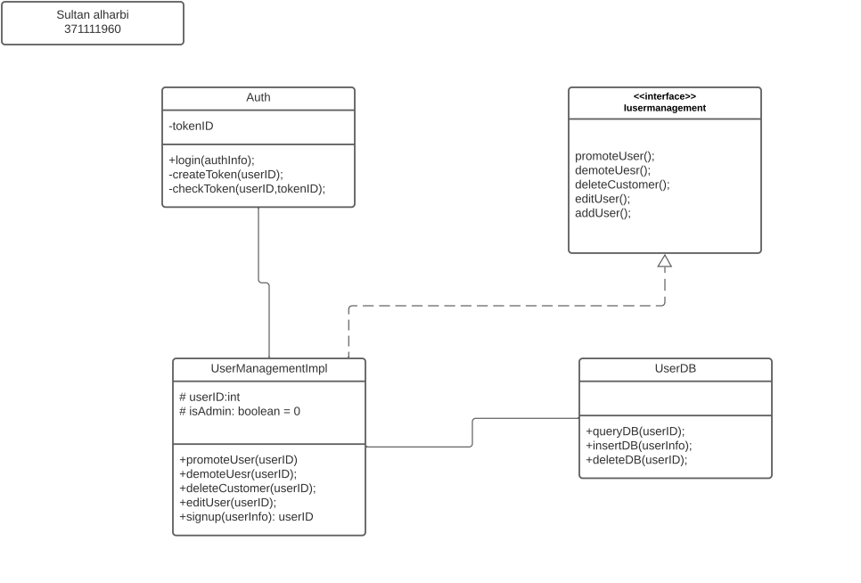
UML class Diagrams cont
Goals from design
Create an interface between the robot and Users
Allows for some user management capability

Slide 11
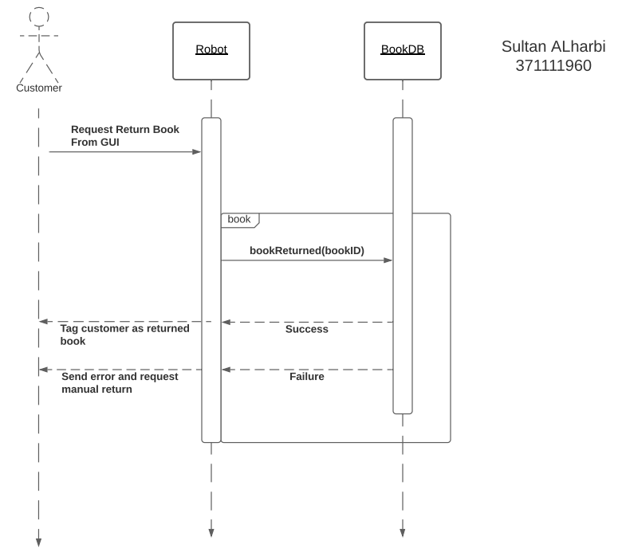
Sequence Diagrams
Sequence for Return Book
Customer clicks on return book and puts book in tray
Robot sends book ID to bookReturned() in bookDB
For every book, BookDB makes sure everything is correct, then sends success or failure
For successful return, the customer is notified and tagged as returned in DB
For failure, the customer is asked to manually return the book.

Slide 12
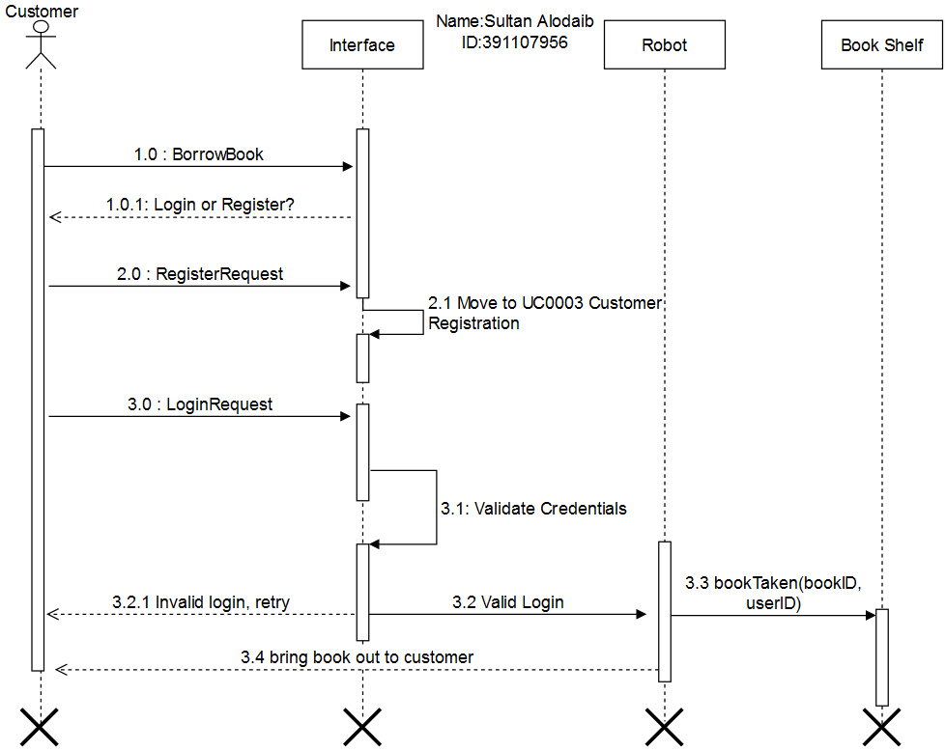
Sequence Diagrams cont
Sequence for Borrow Book
The customer clicks on the option to borrow the book from GUI
Customer is prompted to login or register
In case of register, move on to register customer process
In case of login, validate login then run bookTaken function that tags book and customer as borrowing
Move to book and take it back to customer.

Slide 13
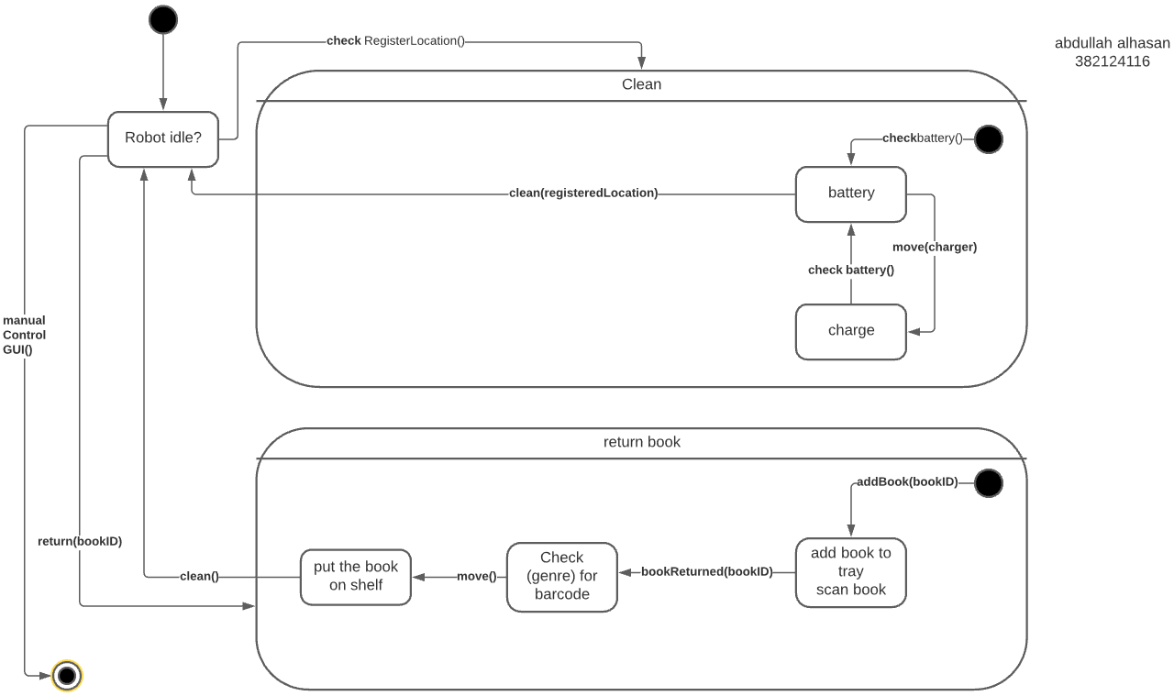
State Diagram

Slide 14

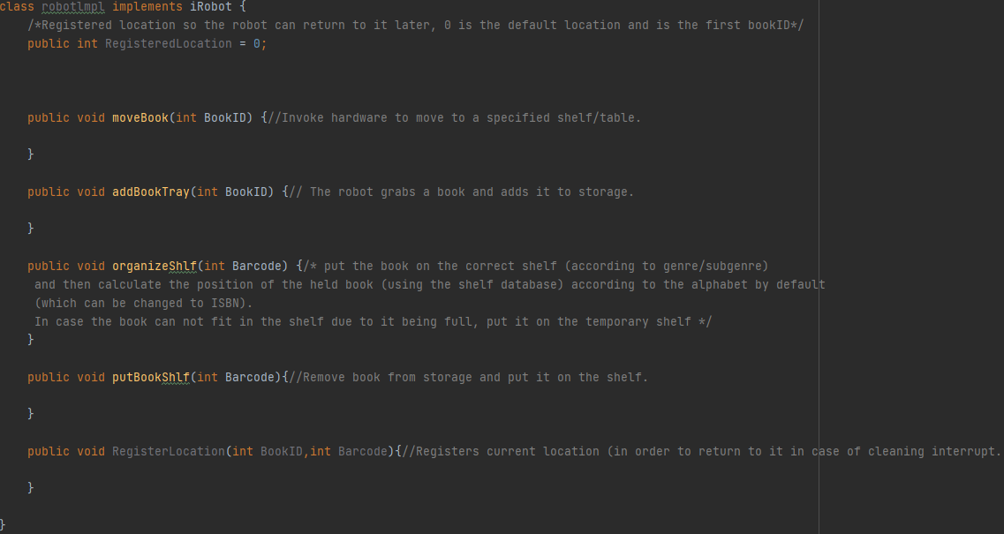
Implementation sample 1

Slide 15
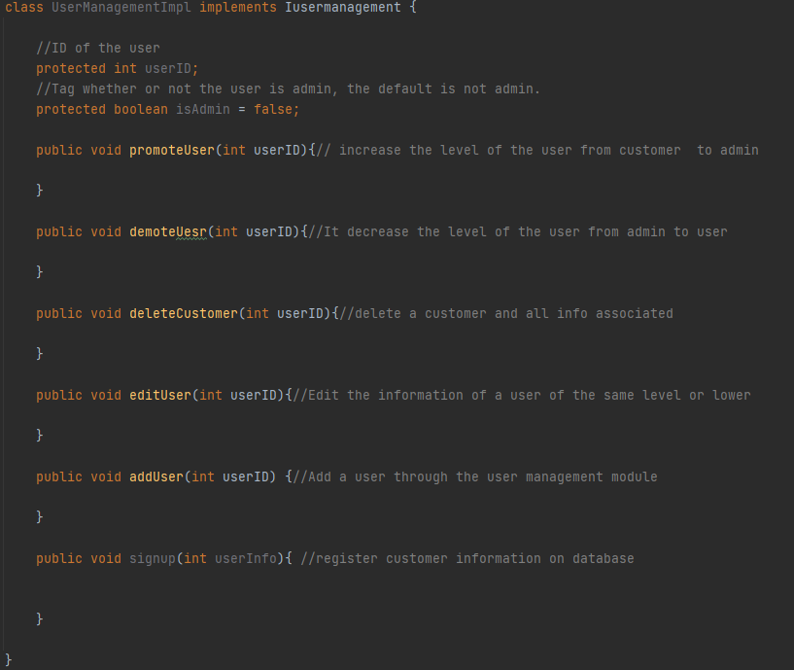
Implementation sample 2

Slide 16
Thank you for listening!
Any questions?

